Slide 1
PRINCIPLES OF GLOBAL ECONOMICS
Chapter 7: Consumers, Producers, and the Efficiency of Markets

Slide 2
Introduction
Principle #5: “Markets are usually a good way to organize economic activity”
So far, we found that markets…
Automatically drive the market price to its equilibrium, and
It matches the market quantity demanded to market quantity supplied.
This automatic adjustment of prices to drive the market is nice…
But how can we be sure that it guarantees that individuals participating in this market the best possible outcome?
In this chapter, we discuss Welfare Economics.

Slide 3
Welfare Economics
Welfare Economics is the study of how the allocation of resources affects economic well-being, examining:
Benefits that buyers and sellers receive from engaging in market transactions.
How society can make these benefits as large as possible.
Allocation of Resources:
How much of each good is produced?
Which producers produce it?
Which consumers consume it?
We begin our study of welfare economics by looking at the benefits buyers receive when participating in the market.

Slide 4
Consumer Surplus

Slide 5
Consumer Surplus
A consumer’s Willingness to Pay (WTP) is the maximum amount that a buyer will pay for a good or service.
A measure of how much the buyer values the good.
If the market’s price is below a consumer’s WTP, the buyer would gladly purchase the good.
If the market’s price is above a consumer’s WTP, they would not purchase the good.
If the market’s price is just at a consumer’s WTP, they would be indifferent about buying the good.
The Consumer Surplus (CS) is the amount a buyer is willing to pay for a good minus the amount the buyer actually pays for it.
This is a monetary measure of the benefits buyers receive from participating in a market.
Consumer Surplus = Willingness to Pay – Price

Slide 6
Consumer Surplus: An Example
Suppose that a few copies of a rare dictionary are up for sale, and there are four interested parties: Winston, Julia, O’Brien, and Charrington.
If the price of the dictionary is set at $700:
Winston and Julia would each purchase one copy.
Winston’s consumer surplus would be $300.
Julia’s consumer surplus would be $100.
How does this relate to demand and supply?
Name | Willingness to Pay
Winston | $1,000
Julia | $800
O’Brien | $500
Charrington | $100

Slide 7
Willingness to Pay to Demand
We can translate this willingness-to-pay table into a demand schedule:
The demand schedule, based on the consumers’ willingness to pay, would be:
Name | Willingness to Pay
Winston | $1,000
Julia | $800
O’Brien | $500
Charrington | $100
Price Range | Purchasing Consumer | Quantity Demanded
Above $1,000
$801 to $1,000
$501 to $800
$101 to $500
$100 or Below
Price Range | Purchasing Consumer | Quantity Demanded
Above $1,000 | Nobody | 0
$801 to $1,000 | Winston | 1
$501 to $800 | Winston & Julia | 2
$101 to $500 | Winston, Julia, & O’Brien | 3
$100 or Below | Everyone | 4

Slide 8
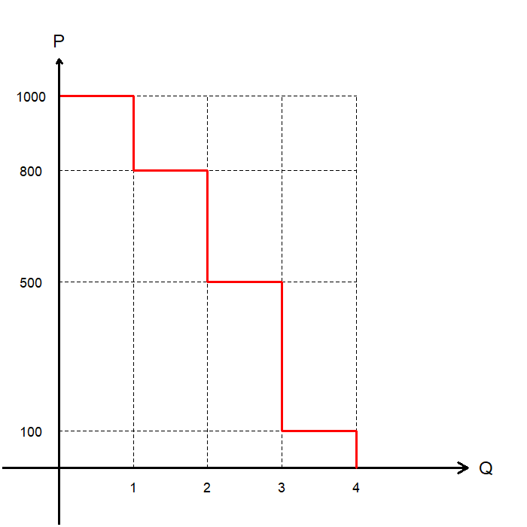
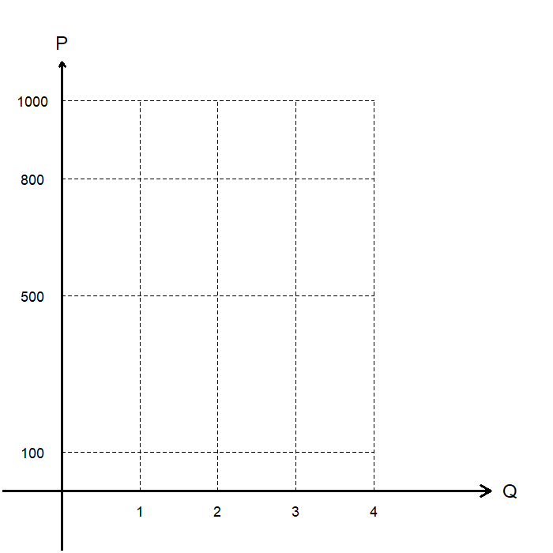
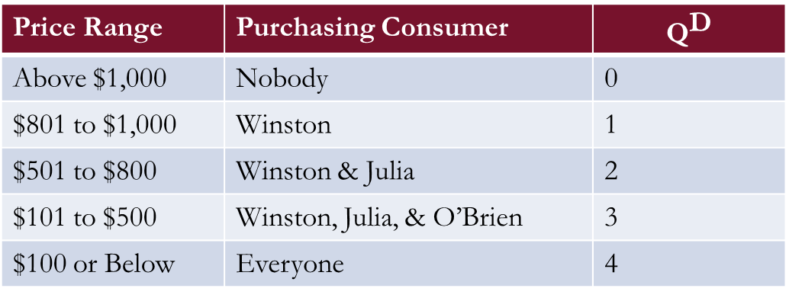
Willingness to Pay to Demand
This demand schedule can be graphed as a “step function.”
This is the demand curve in the market for the copies of the rare dictionary with 4 buyers.
Price Range | Purchasing Consumer | $${\text{Q}}^{\text{D}}$$
Above $1,000 | Nobody | 0
$801 to $1,000 | Winston | 1
$501 to $800 | Winston & Julia | 2
$101 to $500 | Winston, Julia, & O’Brien | 3
$100 or Below | Everyone | 4

Slide 9
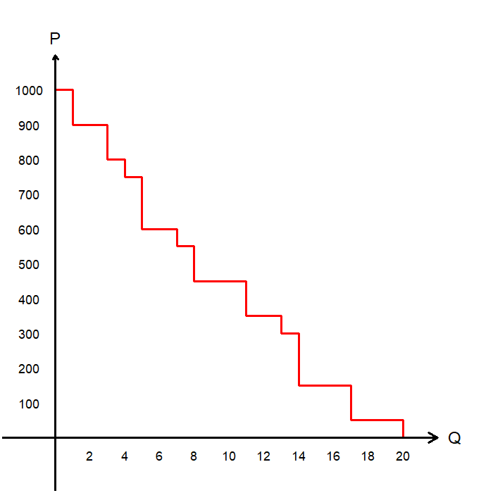
Willingness to Pay to Demand
So, the height of the demand curve represents the willingness to pay of the Marginal Buyer, the buyer who would leave the market if the price was any higher.
With only 4 buyers in the market, the step function looks “choppy” with only 4 “steps.”
If we had 11 buyers with various WTPs, there would be 11 “steps” in this curve.
If we had a large group of buyers, the curve would look smooth.

Slide 10
Willingness to Pay to Demand
Let’s head back to our initial 4-person market.
When Q=1, the height of the demand curve is $1,000, which is Winston’s willingness to pay.
When Q=2, the height of the demand curve is $800, which is Julia’s willingness to pay.
When Q=3, the height of the demand curve is $500, which is O’Brien’s willingness to pay.
When Q=4, the height of the demand curve is $100, which is Charrington’s willingness to pay.

Slide 11
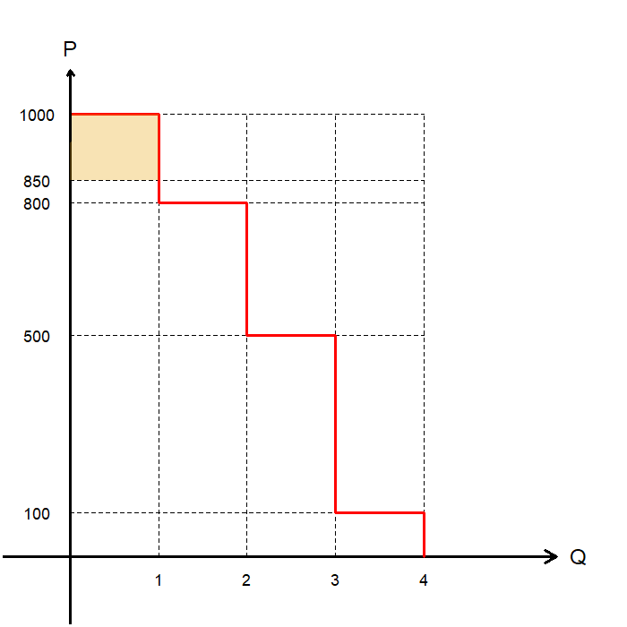
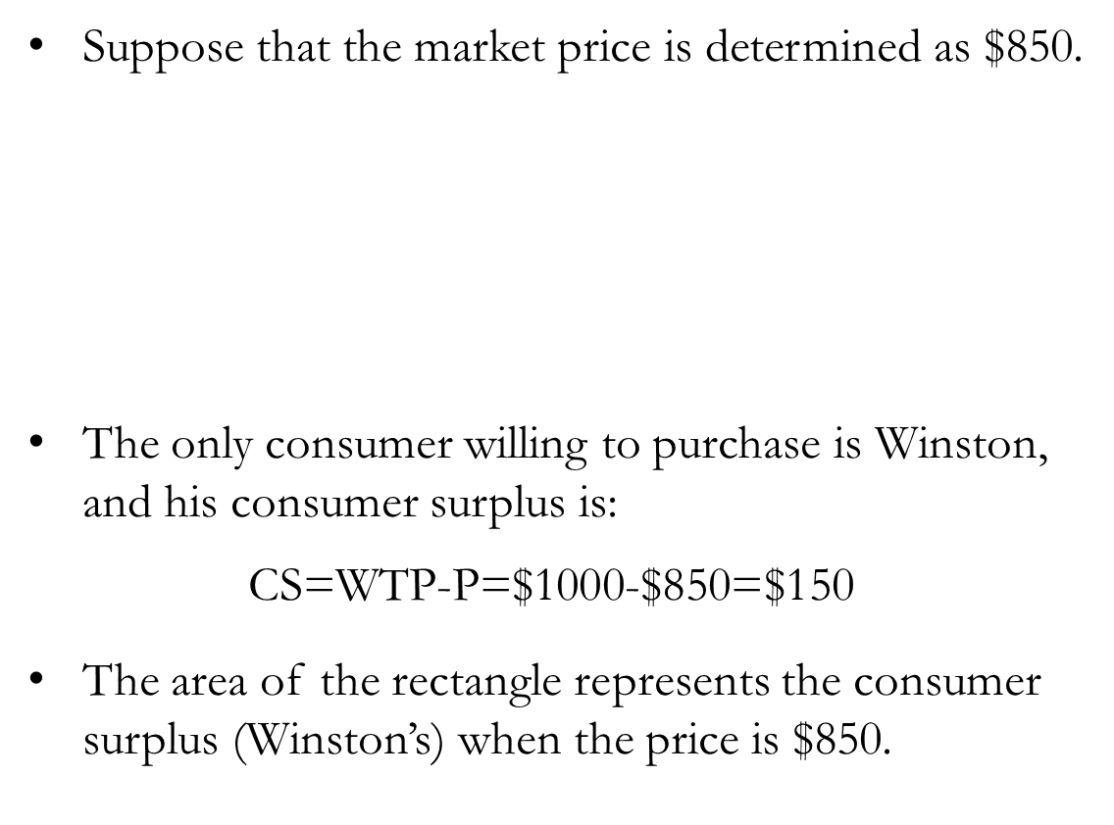
Demand and Consumer Surplus
Suppose that the market price is determined as $850.
The only consumer willing to purchase is Winston, and his consumer surplus is:
$$\text{CS}\text{=}\text{WTP}\text{−}\text{P}\text{=\$1000−\$850=\$150}$$
The area of the rectangle represents the consumer surplus (Winston’s) when the price is $850.
Name | Willingness to Pay
Winston | $1,000
Julia | $800
O’Brien | $500
Charrington | $100

Slide 12
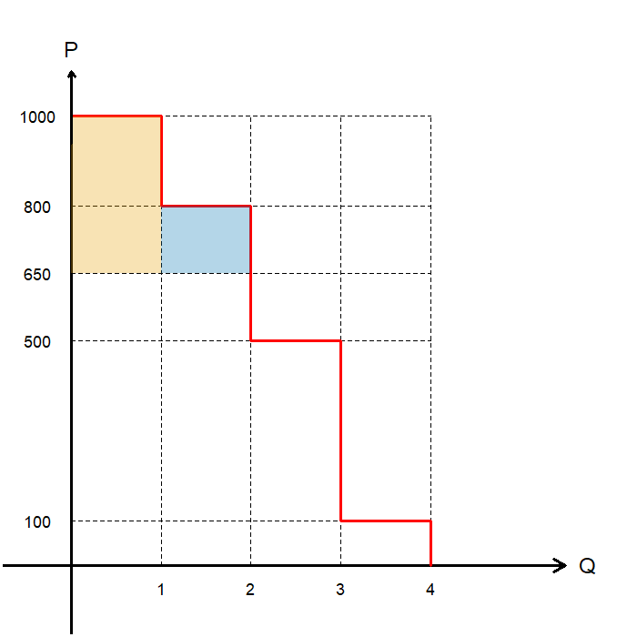
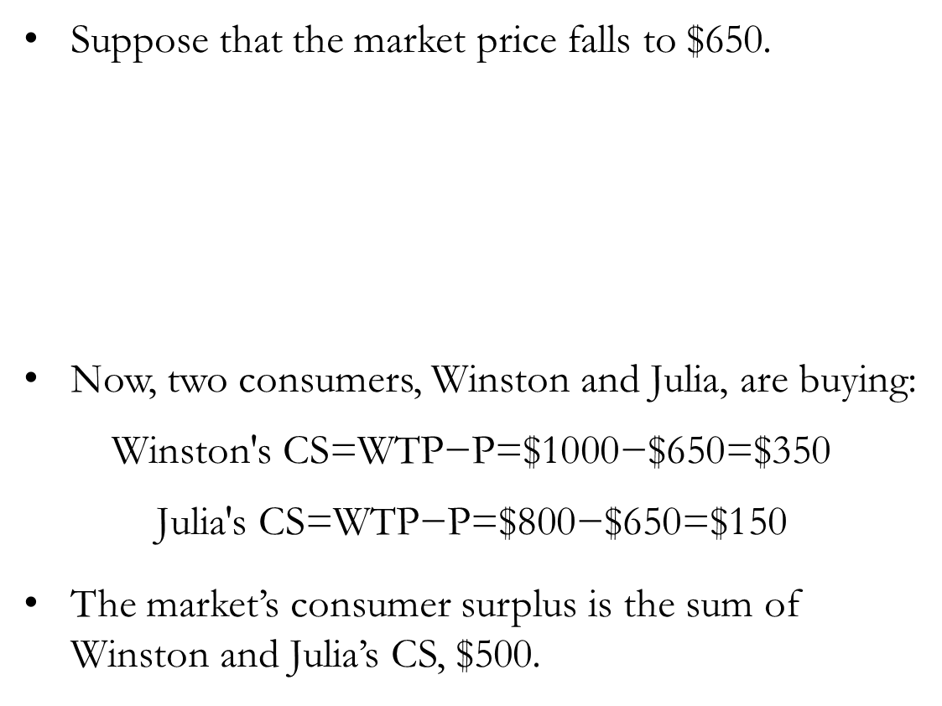
Demand and Consumer Surplus
Suppose that the market price falls to $650.
Now, two consumers, Winston and Julia, are buying:
$$\text{Winston}\text{′}\text{s} \text{CS}\text{=}\text{WTP}\text{−}\text{P}\text{=\$1000−\$650=\$350}$$
$$\text{Julia}\text{′}\text{s} \text{CS}\text{=}\text{WTP}\text{−}\text{P}\text{=\$800−\$650=\$150}$$
The market’s consumer surplus is the sum of Winston and Julia’s CS, $500.
Name | Willingness to Pay
Winston | $1,000
Julia | $800
O’Brien | $500
Charrington | $100

Slide 13
Demand and Consumer Surplus
The height of the demand curve represents the values buyers place on the good: WTP
Each buyer’s consumer surplus (for consumers purchasing the good) is their willingness to pay minus the price.
The sum of the consumer surplus of all buyers in the market is called total consumer surplus, which is the benefit that buyers derive from a market as the buyers themselves perceive it.
In a graph, the area below the demand curve and above the price represents total consumer surplus.

Slide 14
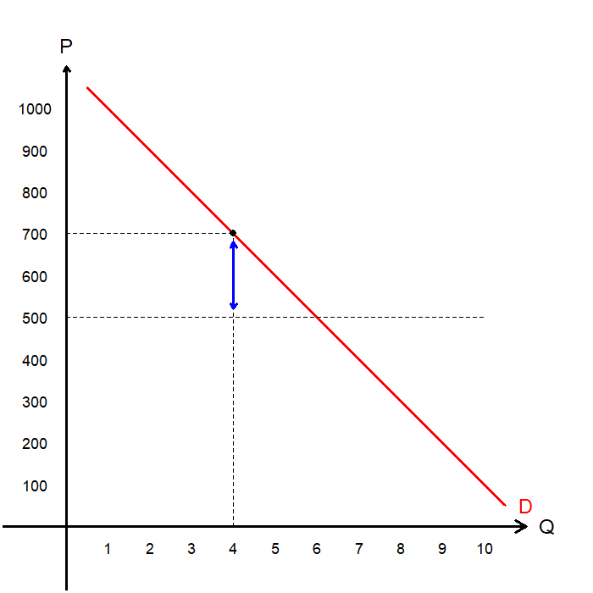
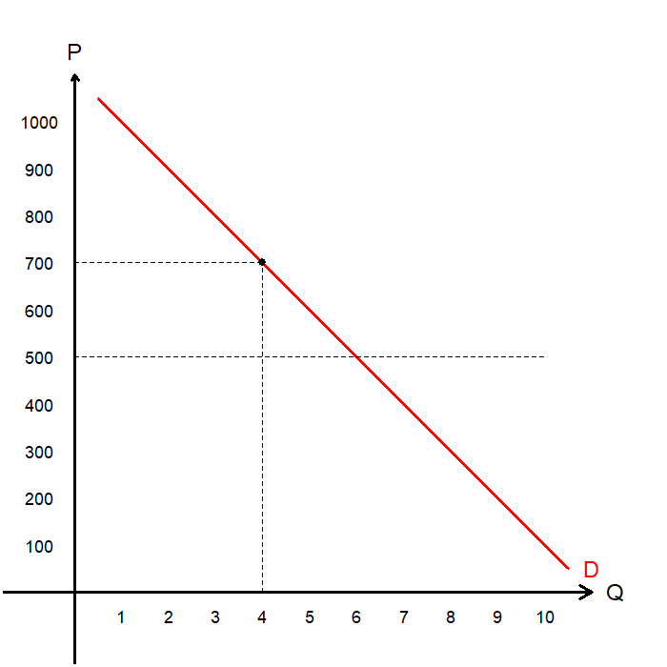
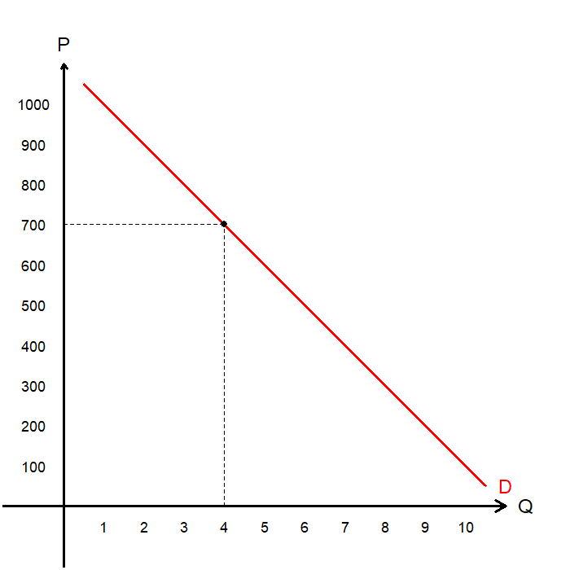
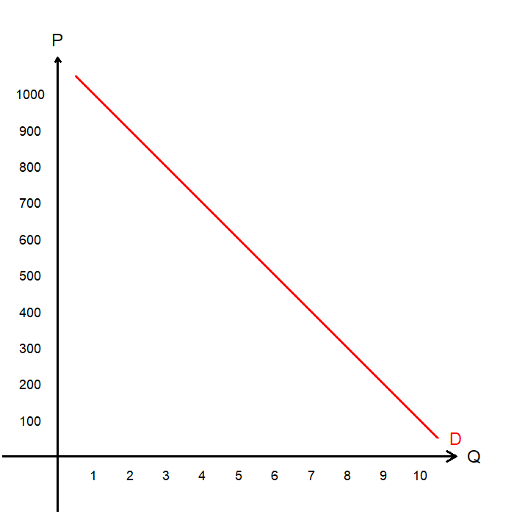
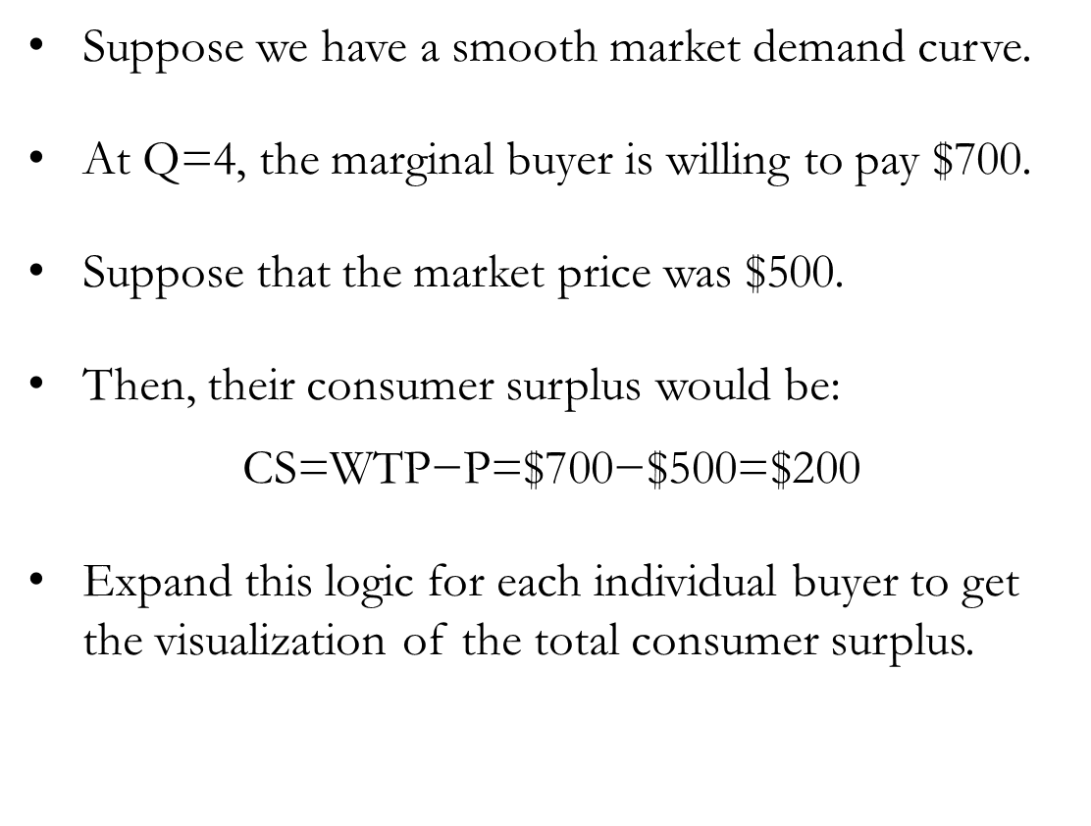
Individual Consumer Surplus
Suppose we have a smooth market demand curve.
At Q=4, the marginal buyer is willing to pay $700.
Suppose that the market price was $500.
Then, their consumer surplus would be:
$$\text{CS}\text{=}\text{WTP}\text{−}\text{P}\text{=\$700−\$500=\$200}$$
Expand this logic for each individual buyer to get the visualization of the total consumer surplus.

Slide 15
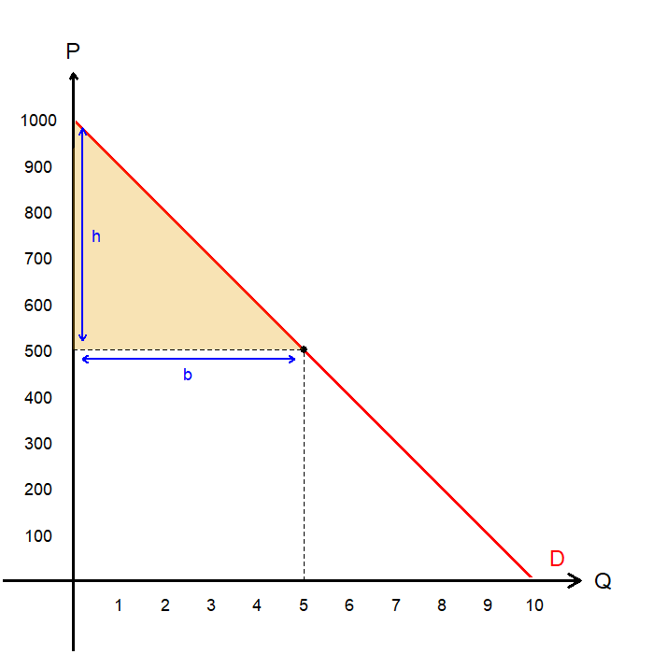
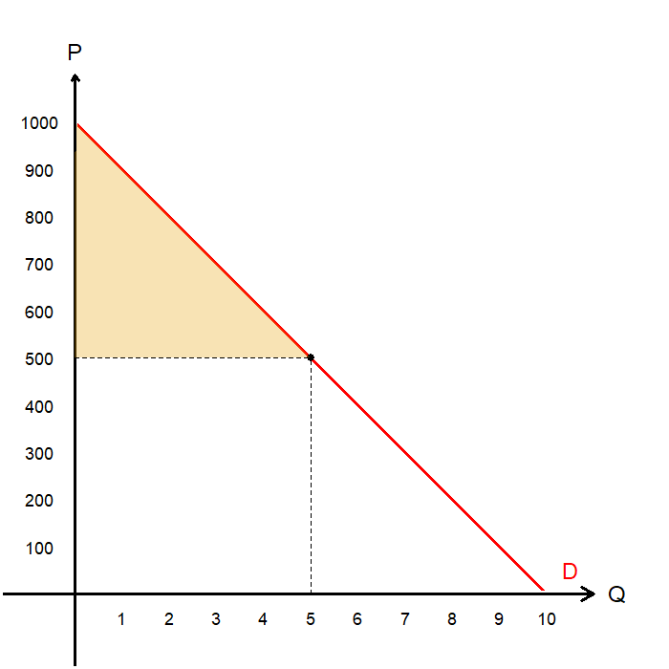
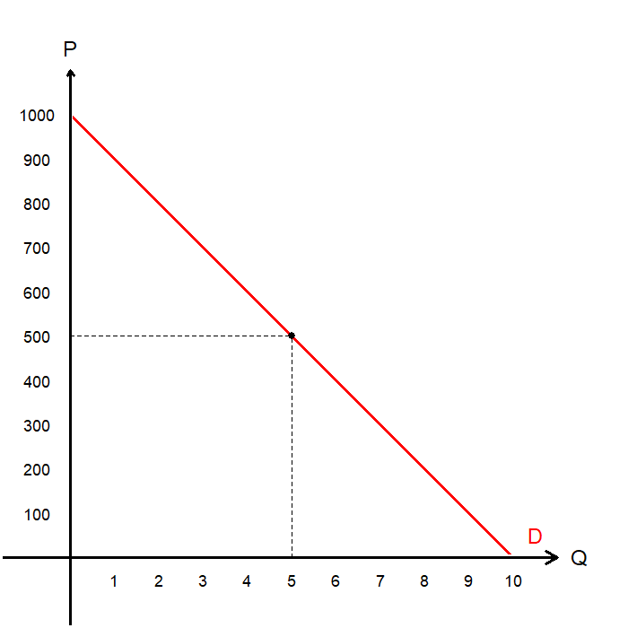
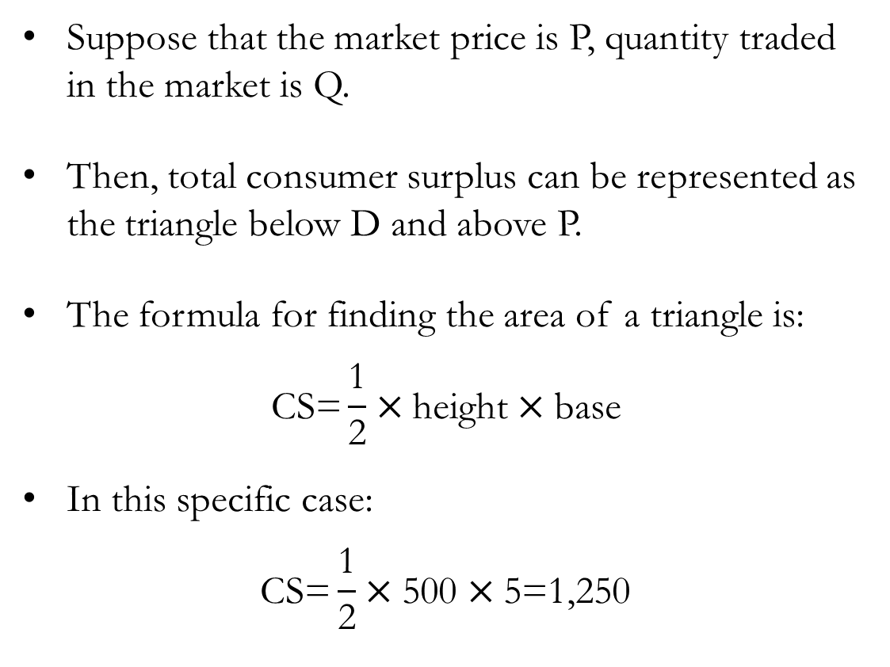
Total Consumer Surplus
Suppose that the market price is P, quantity traded in the market is Q.
Then, total consumer surplus can be represented as the triangle below D and above P.
The formula for finding the area of a triangle is:
$$\text{CS}\text{=}\frac{\text{1}}{\text{2}}×\text{height}×\text{base}$$
In this specific case:
$$\text{CS}\text{=}\frac{\text{1}}{\text{2}}×\text{500}×\text{5=1,250}$$

Slide 16
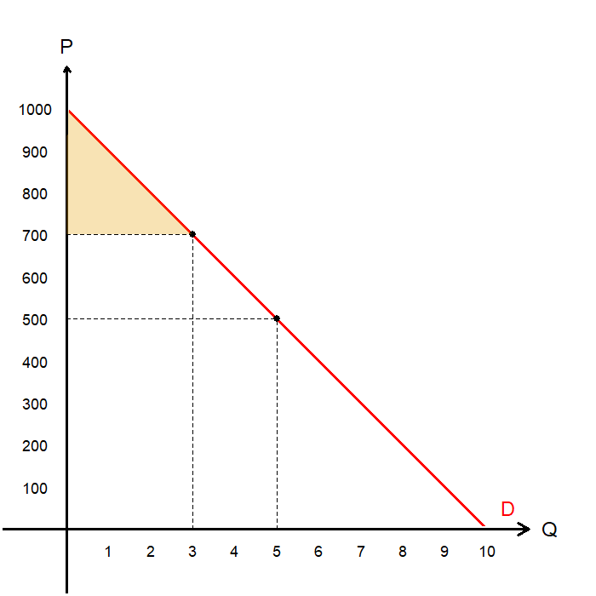
Consumer Surplus and Prices
When prices increase, consumer surplus decreases.
From our previous example, suppose that the price increases to $700.
The new consumer surplus shrinks to $450.
The decrease in total CS comes from two sources:
Some consumers are going to leave the market, as the market price exceeds their WTP.
The remaining consumers would be worse-off due to them paying more for the good.

Slide 17
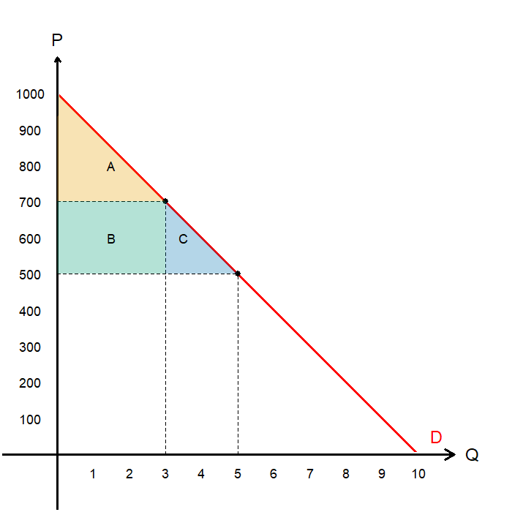
Consumer Surplus and Prices
Expressed in a graph, we find that:
Total CS under market price $500 was A+B+C.
Total CS when prices rise to $700 is A.
C (blue triangle) is the CS lost due to consumers leaving the market as buyers.
B (green rectangle) is the CS lost due to remaining consumers paying more for the good.
Read the textbook for the opposite scenario: CS increases when the market price falls.

Slide 18
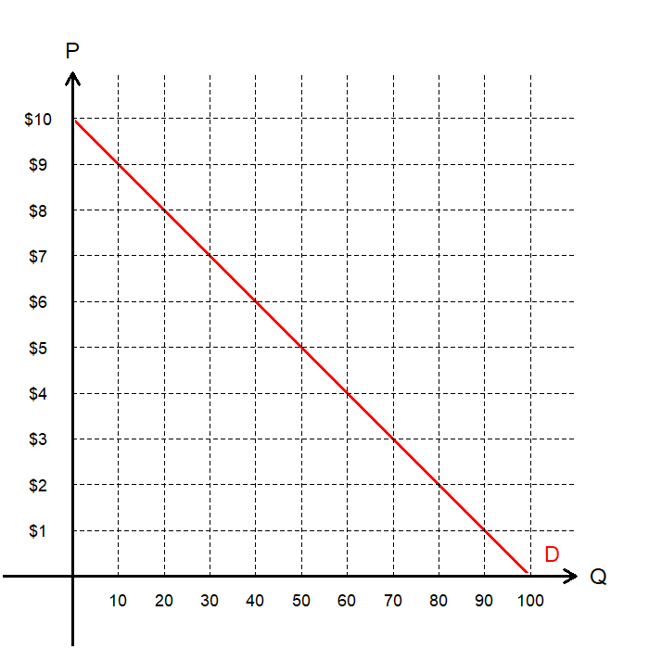
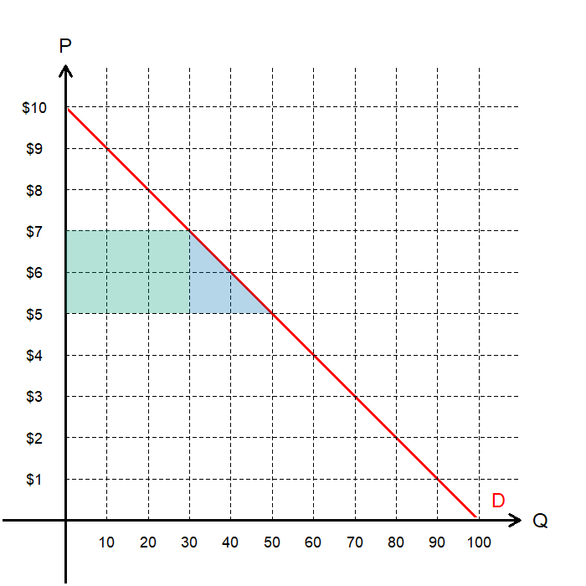
Consumer Surplus: Exercise
What is the marginal buyer’s WTP at…
Q=40:
Find the CS for…
P=$7:
P=$5:
How much of the increase in CS when the price decreases from $7 to $5 is due to…
Buyers entering the market:
Existing buyers paying a lower price:
$6
45
125
60
20

Slide 19
Producer Surplus

Slide 20
Producer Surplus
The cost of production is the value of everything a seller must give up to produce a good, including the opportunity cost.
A producer’s Willingness to Sell (WTS) is the minimum amount that a seller will accept for the sale of a good or service.
The cost is a measure of WTS
The producer only produces and sells goods and services if the price is greater than the cost.
The Producer Surplus (PS) is the amount a seller is paid for a good, minus the sellers’ cost of producing it.
This is a monetary measure of the benefits sellers receive from participating in a market.
Producer Surplus = Price – Willingness to Sell

Slide 21
Willingness to Sell to Supply
Consider a market for fine swords with three sellers: Athos, Porthos, Aramis. Each can produce and sell one sword. The sellers’ willingness to sell is given as:
Based on this information, we can find the supply schedule as:
Name | Willingness to Sell
Athos | $100
Porthos | $200
Aramis | $400
Price Range | Seller | Quantity Supplied
$99 or Below
$100 to $199
$200 to $399
Above $400
Price Range | Seller | Quantity Supplied
$99 or Below | Nobody | 0
$100 to $199 | Athos | 1
$200 to $399 | Athos & Porthos | 2
Above $400 | Everyone | 3

Slide 22
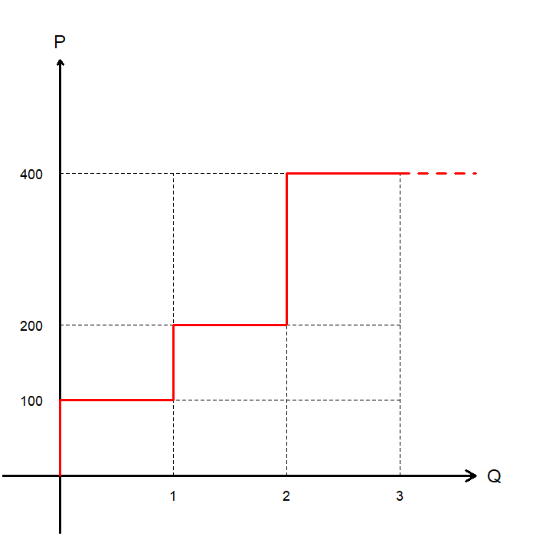
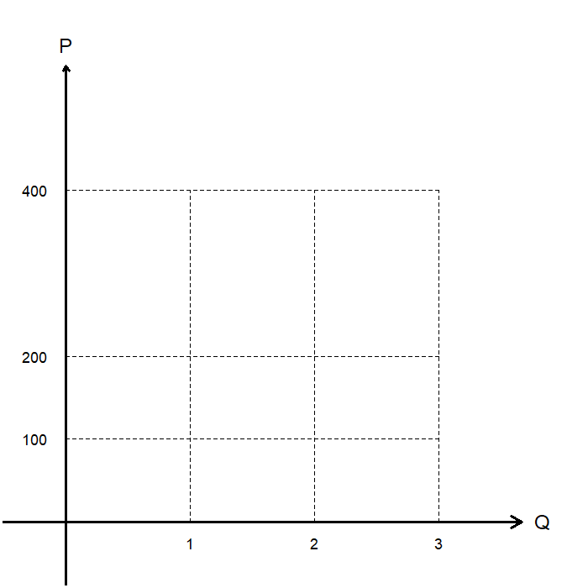
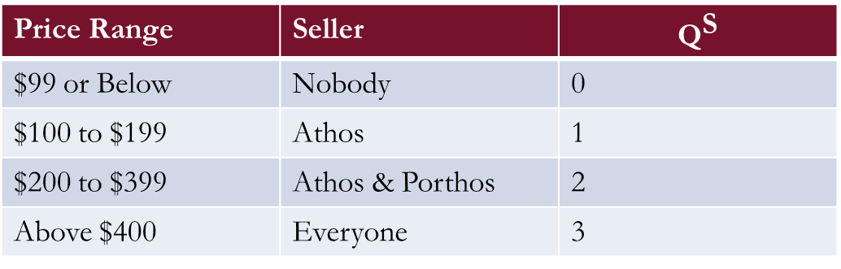
Willingness to Sell to Supply
This supply schedule can be graphed as a “step function,” similar to the case with demand.
This is the supply curve in the market for fine swords with 3 sellers.
Price Range | Seller | $${\text{Q}}^{\text{S}}$$
$99 or Below | Nobody | 0
$100 to $199 | Athos | 1
$200 to $399 | Athos & Porthos | 2
Above $400 | Everyone | 3

Slide 23
Willingness to Sell to Supply
So, the height of the supply curve represents the willingness to sell of the Marginal Seller, the seller who would leave the market if the price was any lower.
We refer to the cost of the marginal seller as Marginal Cost.
Similar to the “choppy” demand function’s case, as we add more sellers to this market, the supply curve gets smoother.

Slide 24
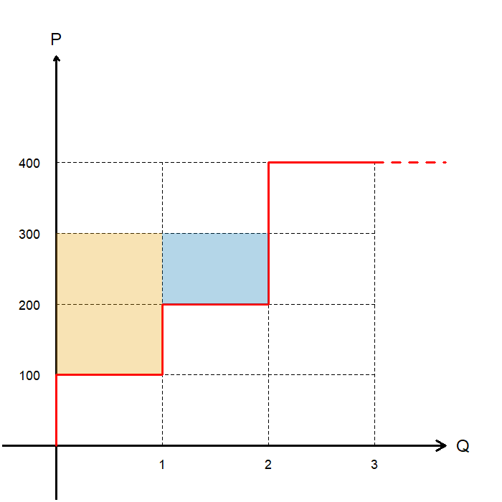
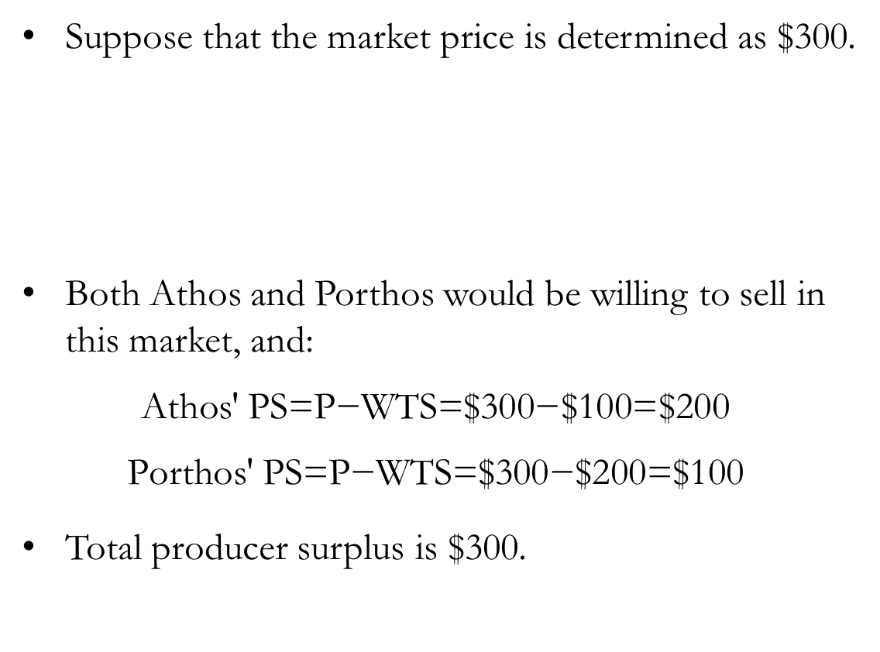
Supply and Producer Surplus
Suppose that the market price is determined as $300.
Both Athos and Porthos would be willing to sell in this market, and:
$$\text{Athos}\text{′ }\text{P}\text{S}\text{=}\text{P}\text{−}\text{WTS}\text{=\$}\text{300}\text{−\$}\text{100}\text{=\$}\text{20}\text{0}$$
$$\text{Porthos}\text{′ }\text{P}\text{S}\text{=}\text{P}\text{−}\text{WTS}\text{=\$}\text{300}\text{−\$}\text{200}\text{=\$1}\text{0}\text{0}$$
Total producer surplus is $300.
Name | Willingness to Sell
Athos | $100
Porthos | $200
Aramis | $400

Slide 25
Supply and Producer Surplus
The height of the supply curve represents the cost of producing the good: WTS
Each seller’s producer surplus (for sellers selling the good) is the market price minus their willingness to sell.
The sum of the producer surplus of all sellers in the market is called total producer surplus, which is the benefit that sellers derive from a market.
In a graph, the area below the market price and above the supply curve represents total producer surplus.

Slide 26
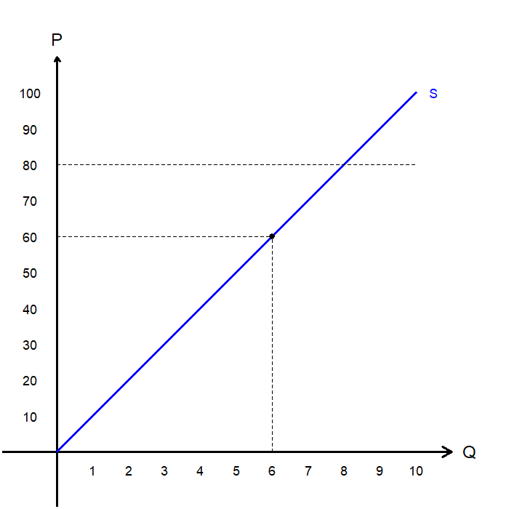
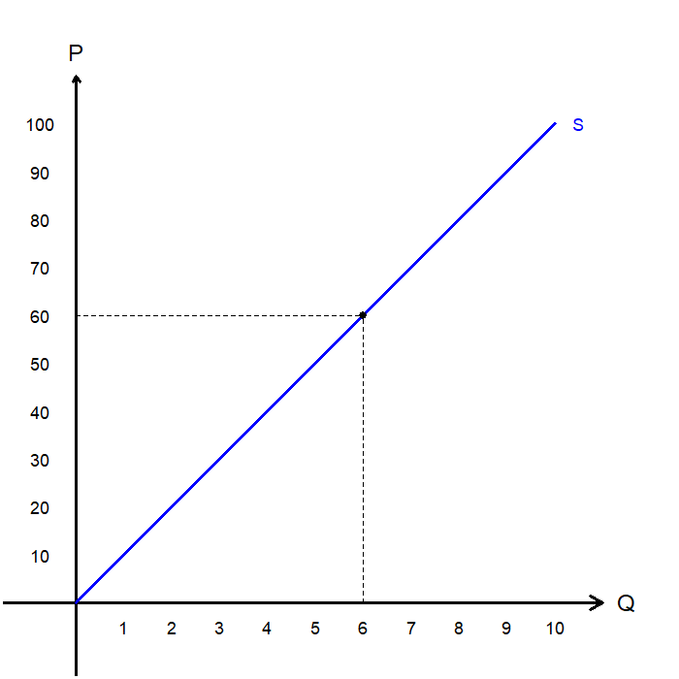
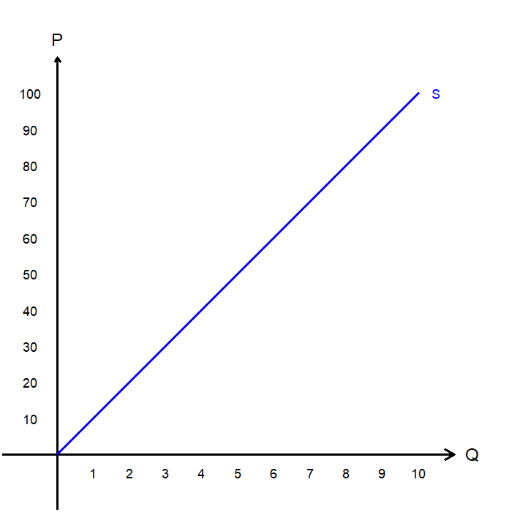
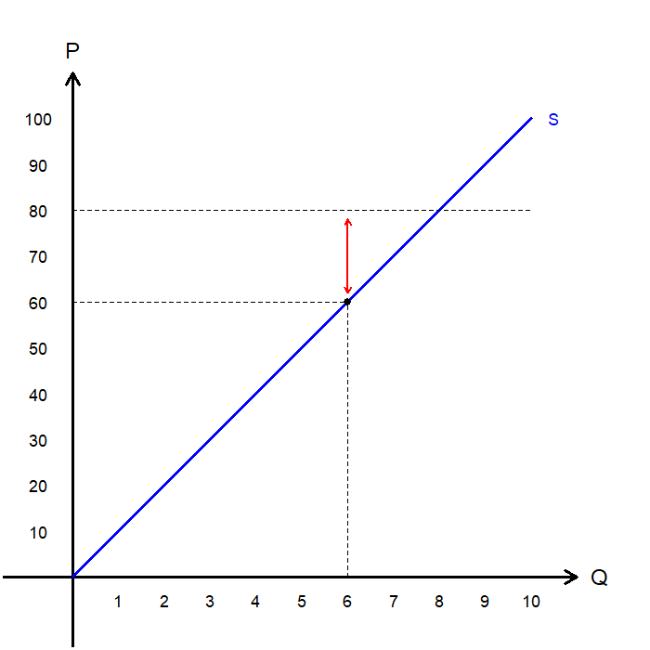
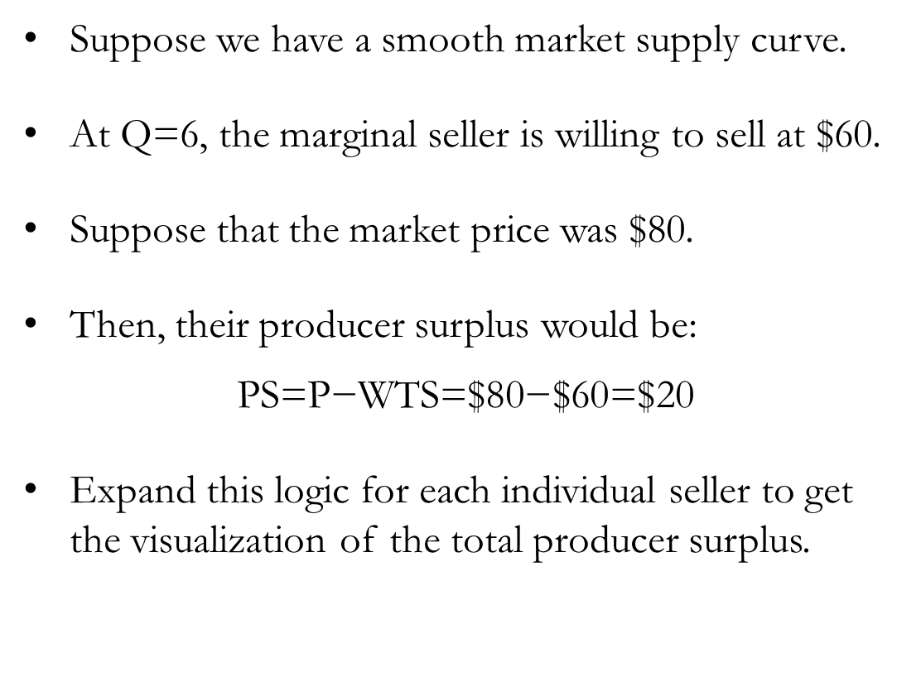
Individual Producer Surplus
Suppose we have a smooth market supply curve.
At Q=6, the marginal seller is willing to sell at $60.
Suppose that the market price was $80.
Then, their producer surplus would be:
$$\text{P}\text{S}\text{=}\text{P}\text{−}\text{WTS}\text{=\$}\text{8}\text{0−\$}\text{6}\text{0=\$}\text{2}\text{0}$$
Expand this logic for each individual seller to get the visualization of the total producer surplus.

Slide 27
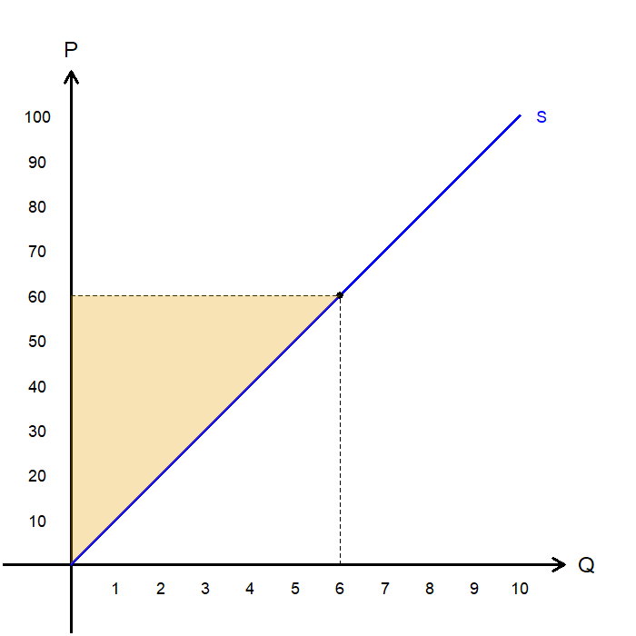
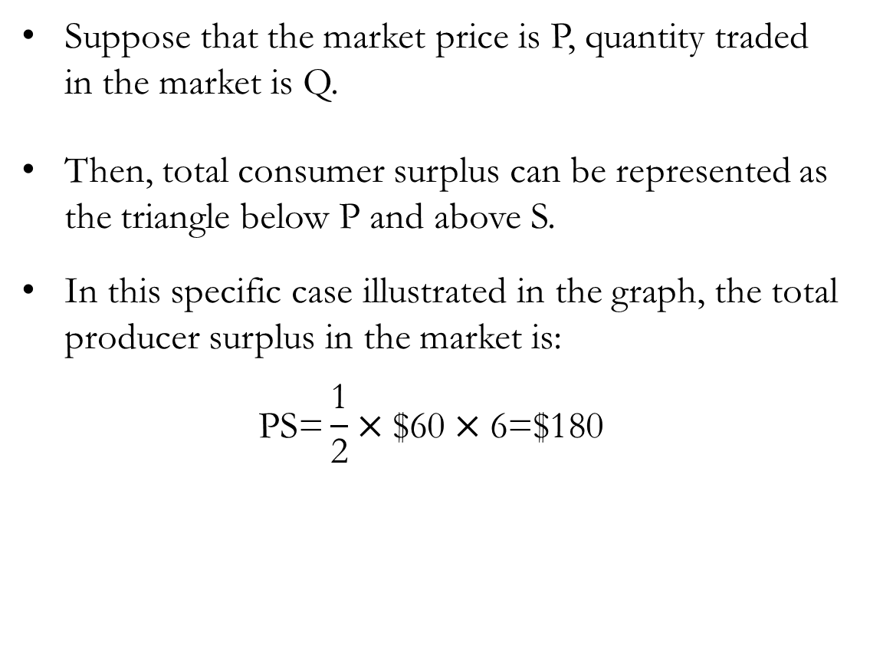
Total Producer Surplus
Suppose that the market price is P, quantity traded in the market is Q.
Then, total consumer surplus can be represented as the triangle below P and above S.
In this specific case illustrated in the graph, the total producer surplus in the market is:
$$\text{P}\text{S}\text{=}\frac{\text{1}}{\text{2}}×\text{\$}\text{60}×\text{6=}\text{\$}\text{180}$$

Slide 28
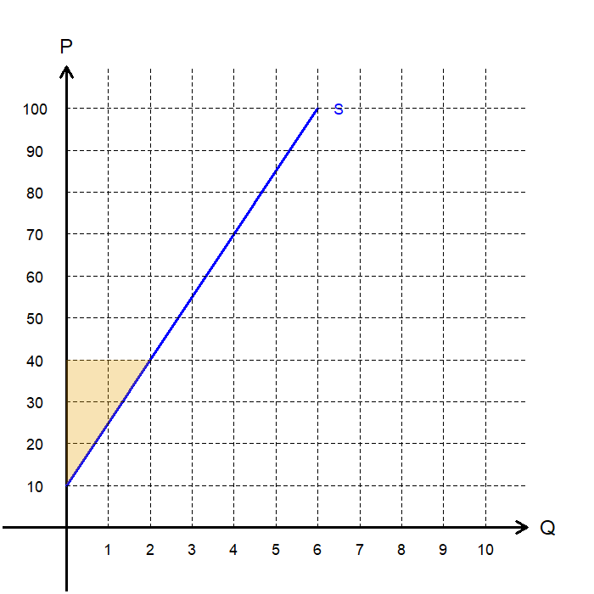
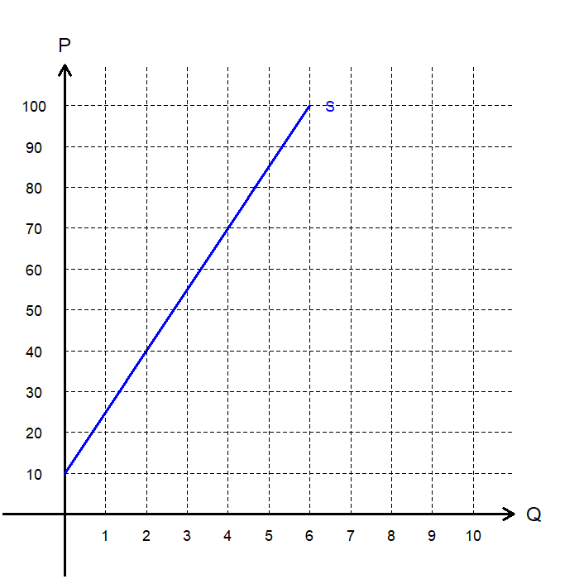
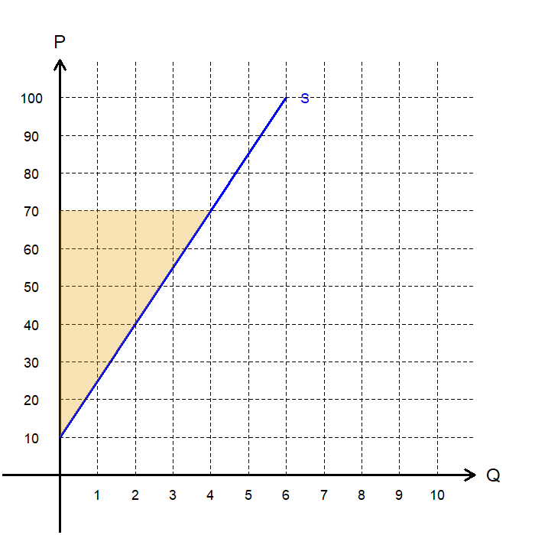
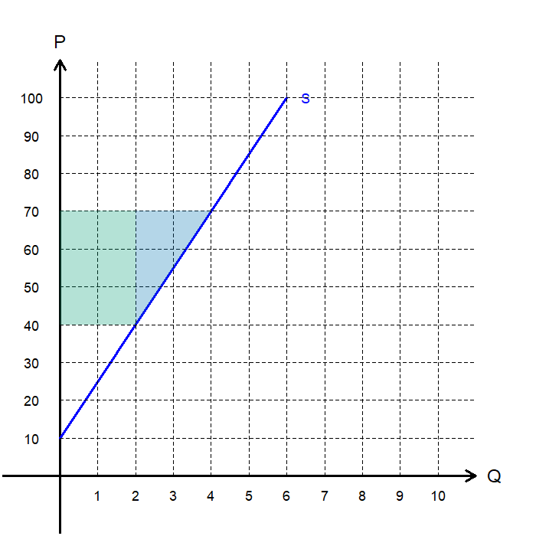
Producer Surplus: Exercise
What is the marginal seller’s WTS at…
Q=4:
Find the PS for…
P=$40:
P=$70:
How much of the increase in PS when the price increases from $40 to $70 is due to…
Sellers entering the market:
Existing sellers receiving a higher price:
$70
$30
$120
$60
$30

Slide 29
The Efficiency of Markets

Slide 30
Social Planners
The central question: “Do competitive markets reach a desirable allocation of resources?”
We rephrase this question: “If there were a benevolent, omniscient, and omnipotent social planner seeking to maximize societal well-being, what would they do?”
Societal well-being can be defined in many ways, with one of the most prominent debates focusing on the balance between:
Efficiency: Maximizing the total surplus received by all members of society.
Equality: Distributing economic prosperity uniformly among the members of society.
In this introduction to welfare economics, we assume that the social planner defines societal well-being in terms of efficiency.

Slide 31

Total Surplus
Specifically, we assume that the social planner aims to maximize Total Surplus, the sum of total consumer surplus and total producer surplus.
Recall that:
So, total surplus, which is consumer surplus and producer surplus together:
Note that this relationship holds when the price paid by buyers and price received by sellers are equal.
$$\text{Consumer} \text{Surplus}\text{ = }\text{Value} \text{to} \text{Buyers}\text{ − }\text{Price} \text{Paid} \text{by} \text{Buyers}$$
$$\text{Producer} \text{Surplus}\text{ = }\text{Price} \text{Received} \text{by} \text{Sellers}\text{ − }\text{Cost} \text{to} \text{Sellers}$$
$$\text{Total} \text{Surplus}\text{ = }\text{Value} \text{to} \text{Buyers}\text{ − }\text{Cost} \text{to} \text{Sellers}$$

Slide 32
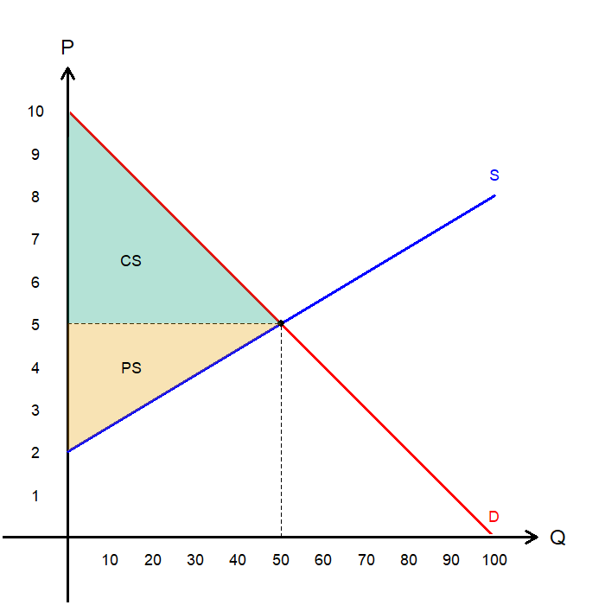
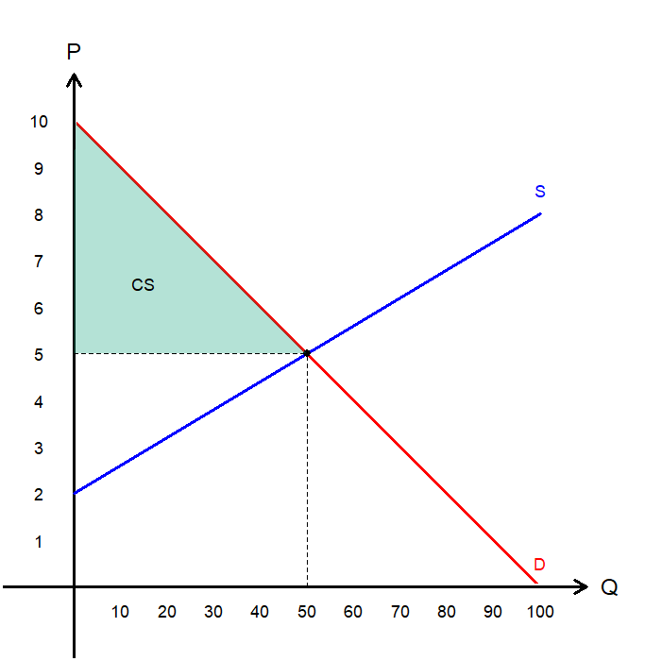
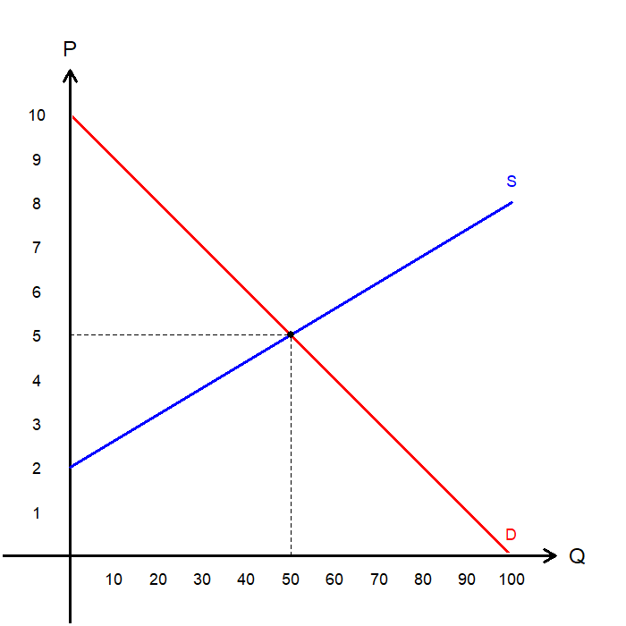
Total Surplus
Suppose that the market is in equilibrium at P=5 and Q=50.
Consumer surplus is the area above P and below D.
In this example, CS is $125.
Producer surplus is the area above S and below P.
In this example, PS is $75.
Total surplus is CS + PS.
In this example, total surplus is $200.

Slide 33
Competitive Markets and Efficiency
Three claims on competitive markets.
Competitive markets allocate the supply of goods to the buyers who value them most, as measured by their WTP.
Competitive markets allocate the demand for goods to the sellers who can produce them at the lowest cost.
Competitive markets at equilibrium, produce the quantity of goods that maximizes the sum of consumer and producer surplus.

Slide 34
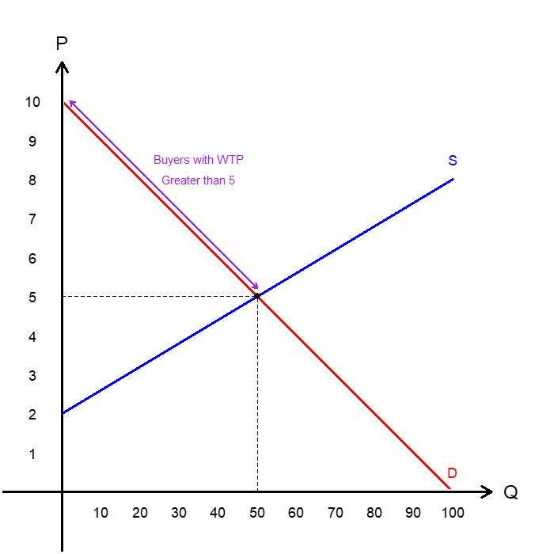
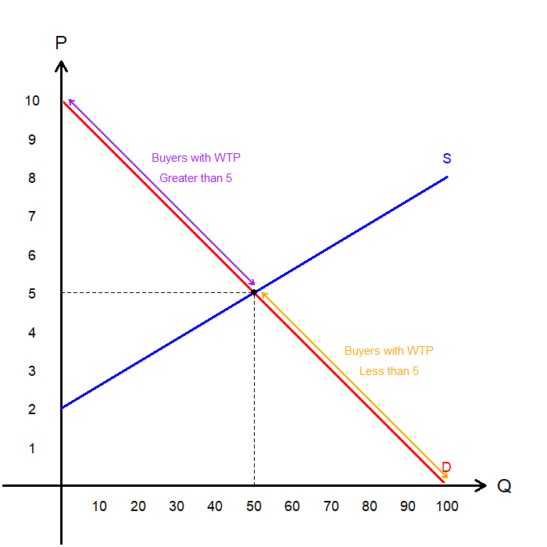
Claim #1: Markets Allocate Goods to Buyers with Greater WTP
Consider the market with equilibrium P=5 and Q=50.
The consumers who participate in the market are those whose WTP is greater than or equal to the market price.
In this example, any consumer whose WTP is ≥ 5 buys.
The consumers whose WTP is less than the market price are “priced out” of the market and cannot buy.
In this example, any consumer whose WTP is < 5 is not able to buy.
The market therefore ensures that buyers who value the good most highly are the ones who consume it.

Slide 35
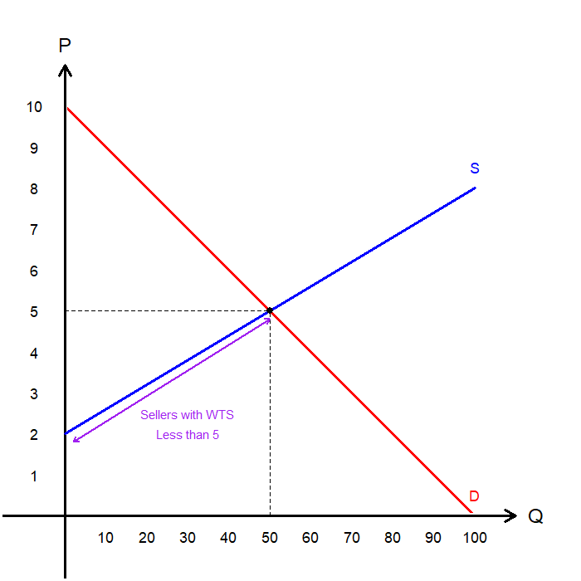
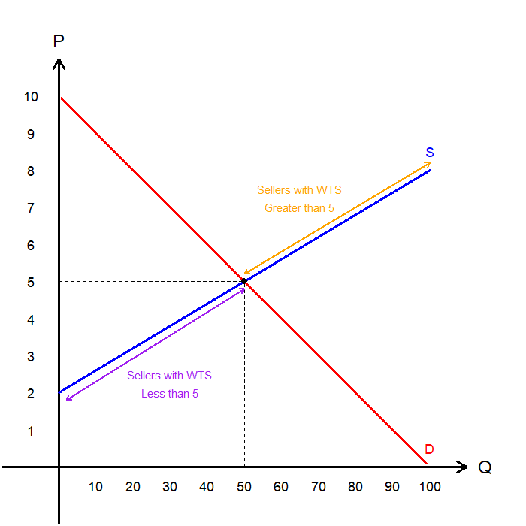
Claim #2: Markets Allow Cost-Minimizing Sellers to Sell First
Consider the market with equilibrium P=5 and Q=50.
The sellers who participate in the market are those whose WTS is less than or equal to the market price.
In this example, any producer whose WTS is ≤ 5 is able to sell their goods.
The producers whose WTS is greater than the market price are “priced out” of the market and cannot sell.
In this example, any producer whose WTS is > 5 is not able to sell their goods.
The market ensures that sellers who can produce at lower costs (lower WTS) are the ones who sell.

Slide 36
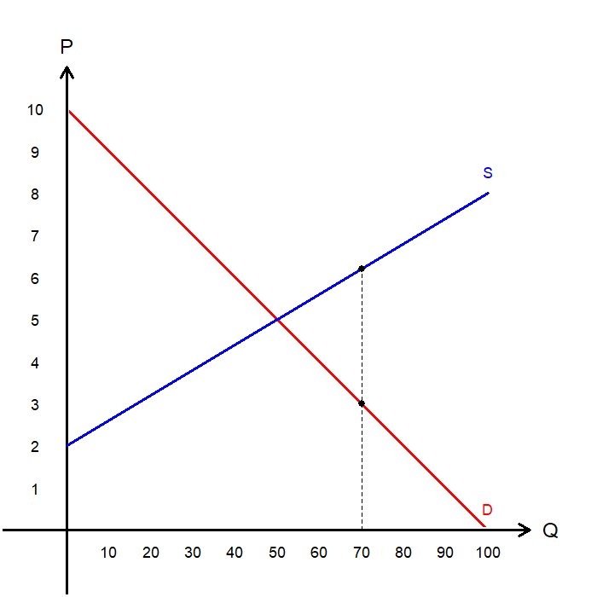
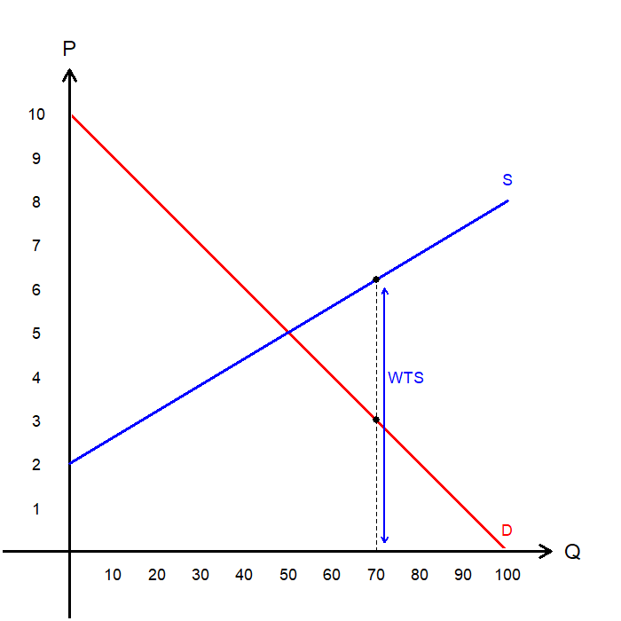
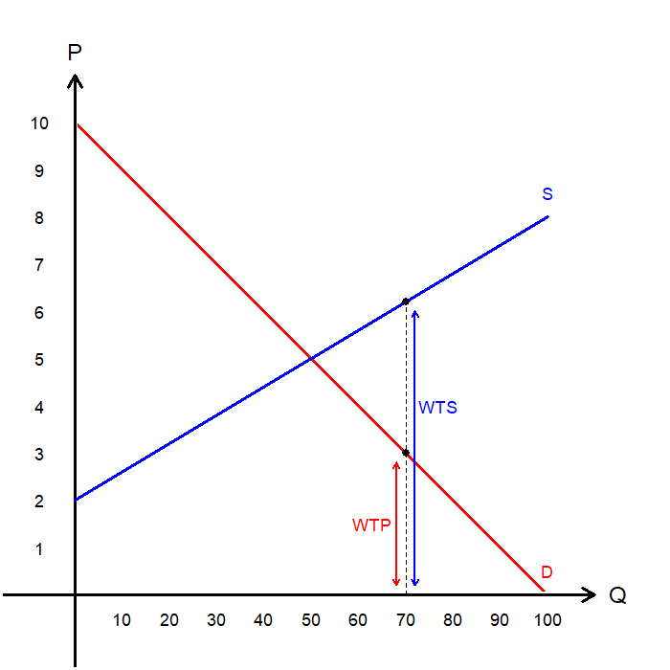
Claim #3: Markets Maximize Total Surplus
Suppose that in this market, quantity is set at Q=70.
The marginal seller’s cost of producing the 70th unit is $6.
The marginal buyer’s benefit from consuming the 70th unit is $3.
The cost of producing the 70th unit is greater than the value that unit provides to consumers.
Total surplus can be increased by reducing Q, and this is true for any Q greater than the equilibrium quantity.

Slide 37
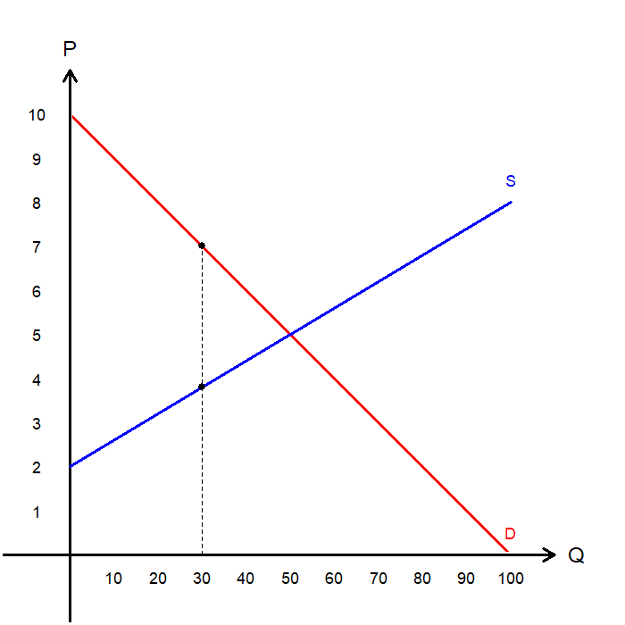
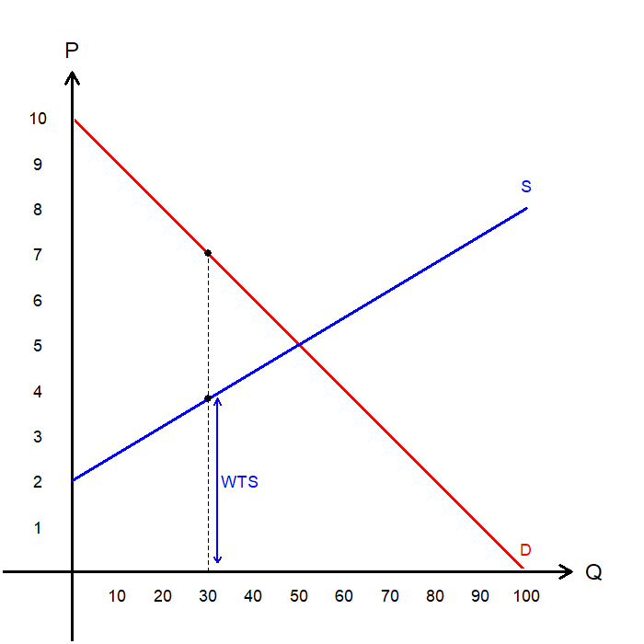
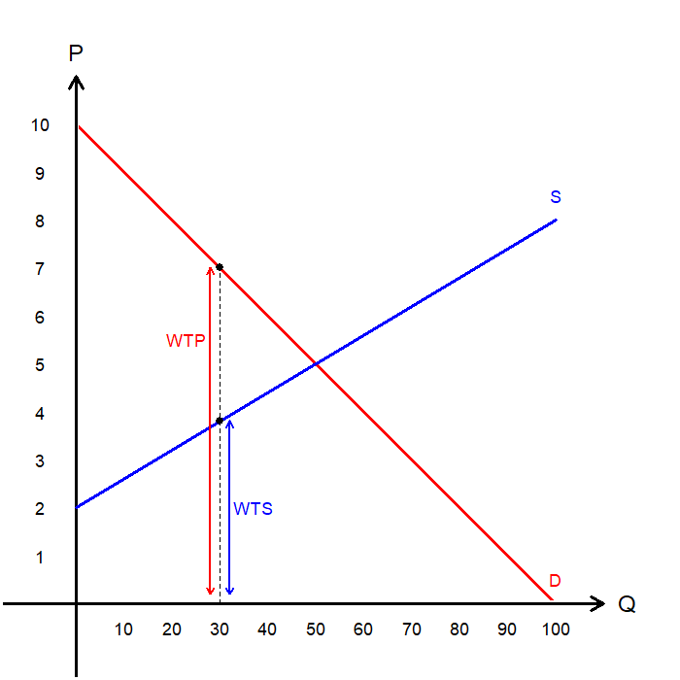
Claim #3: Markets Maximize Total Surplus
Suppose that in this market, quantity is set at Q=30.
The marginal seller’s cost of producing the 30th unit is $4.
The marginal buyer’s benefit from consuming the 30th unit is $7.
The value that consumers receive from the 30th unit is greater than the cost of producing it.
Total surplus can be increased by increasing Q, and this is true for any Q less than the equilibrium quantity.

Slide 38

Competitive Markets and Efficiency
If a social planner tried to choose an efficient allocation, they would need perfect information on:
Every potential buyer’s valuation of every good or service.
Every potential seller’s cost of producing every good or service.
Fortunately, the forces of supply and demand naturally allocate resources efficiently.
Therefore, if a social planner wanted to maximize societal well-being (measured by total surplus), they could simply rely on the market.

Slide 39

The Invisible Hand: Revisited
Adam Smith’s Wealth of Nations
It is not from the benevolence of the butcher, the brewer, or the baker that we expect our dinner, but from their regard to their own interest. Every individual… neither intends to promote the public interest, nor knows how much he is promoting it…. He intends only his own gain, and he is in this, as in many other cases, led by an invisible hand to promote an end which was no part of his intention…. By pursuing his own interest, he frequently promotes that of the society more effectually than when he really intends to promote it.

Slide 40
Market Efficiency
and Market Failures

Slide 41
Market Efficiency?
We found that the forces of supply and demand push the market toward an efficient outcome, without external intervention.
However, this conclusion rests on two assumptions:
Markets are perfectly competitive.
Market outcomes matter only to those directly participating in the market.
In the real world, some producers wield market power, giving them influence over prices.
e.g. OPEC as a bloc can exert considerable power over the price of petroleum.
In the real world, some activities generate externalities, where market transactions affect bystanders.
e.g. Burning coal for energy causes air pollution, which impacts nearby residents.

Slide 42
Market Failure
Market failures occur when unregulated markets are unable to allocate resources efficiently.
Market power and externalities are common examples of market failures in the real world.
When market failures arise, public policy has the potential to improve economic efficiency.
We return to this concept of market failures in the following chapters.

Slide 43
Recap of Chapter 7

Slide 44
Recap
Consumer Surplus:
The buyer’s willingness to pay minus the amount actually paid.
A measure of the benefit buyers receive from participating in a market.
Represented by the area above P and below D.
Producer Surplus:
The price sellers receive minus their willingness to sell (cost of production).
A measure of the benefit sellers receive from participating in a market.
Represented by the area above S and below P.
Total Surplus:
The sum of consumer surplus and producer surplus.
An allocation of resources that maximizes total surplus is said to be efficient.

Slide 45
Recap
The Efficiency of Markets
The invisible hand of the market leads buyers and sellers in competitive markets to allocate resources efficiently.
Policymakers concerned with efficiency can therefore rely on market mechanisms.
However, policymakers may also care about equality, which the market does not guarantee.
Market Failure
Markets fail to allocate resources efficiently when the assumptions of perfect competition do not hold.
In the presence of such failures, external intervention may help restore efficiency.

